Slide 1
Techniques used for Structuring the Page Table
Some of the common techniques that are used for structuring the Page table are as follows:
Hierarchical Paging/ Multilevel paging
Hashed Page Tables
Inverted Page Tables

Slide 2
Hierarchical Paging
Another name for Hierarchical Paging is multilevel paging.
There might be a case where the page table is too big to fit in a contiguous space, so we may have a hierarchy with several levels.
In this type of Paging the logical address space is broke up into Multiple page tables.
Hierarchical Paging is one of the simplest techniques and for this purpose, a two-level page table and three-level page table can be used.

Slide 3
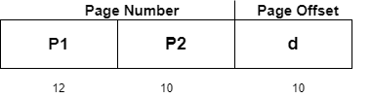
Two Level Page Table
Consider a system having 32-bit logical address space and a page size of 1 KB and it is further divided into:
Page Number consisting of 22 bits.
Page Offset consisting of 10 bits.
As we page the Page table, the page number is further divided into :
Page Number consisting of 12 bits.
Page Offset consisting of 10 bits.
Thus the Logical address is as follows:

Slide 4
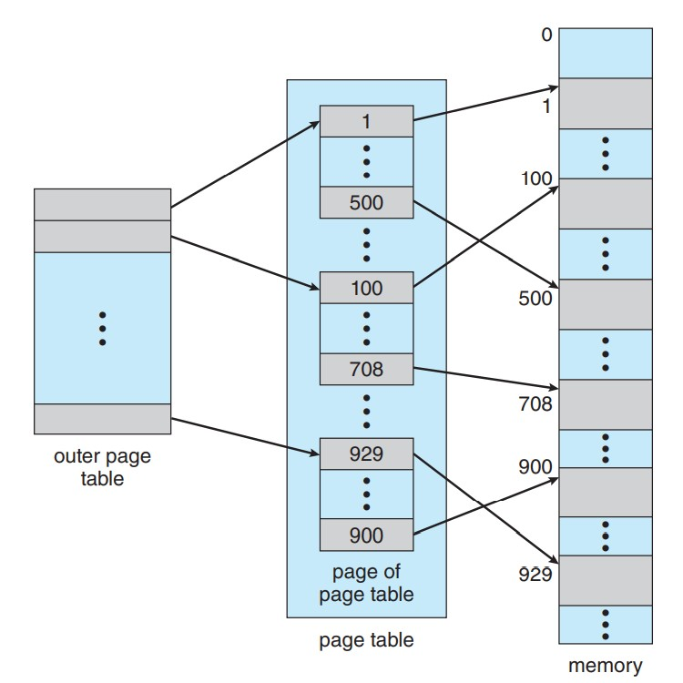
Fig. Two level page scheme

Slide 5
In the above diagram,
P1 is an index into the Outer Page table.
P2 indicates the displacement within the page of the Inner page Table.
As address translation works from outer page table inward so is known as forward-mapped Page Table.
Below given figure below shows the Address Translation scheme for a two-level page table

Slide 6
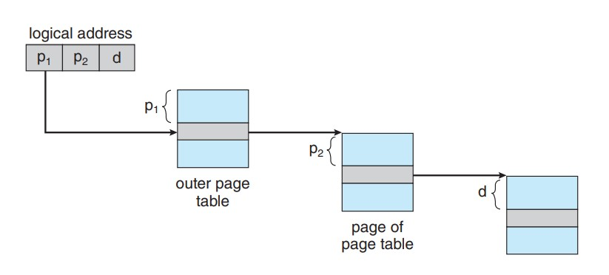
Fig. Address translation for a two-level 32-bit paging architecture

Slide 7


Three Level Page Table
For a system with 64-bit logical address space, a two-level paging scheme is not appropriate.
Let us suppose that the page size, in this case, is 4KB.
If in this case, we will use the two-page level scheme then the addresses will look like this:
Thus in order to avoid such a large table, there is a solution and that is to divide the outer page table, and then it will result in a Three-level page table:

Slide 8
Hashed Page Tables
Hashed page tables are a technique for structuring page tables in memory.
In a hashed page table, the virtual addresses are hashed into the hash table.
Each element in the table comprises a linked list of elements to avoid collisions.
The hash value used is the virtual page number, i.e., all the bits that are not part of the page offset.
Each element in the hash table has the virtual page number, the value of the mapped page, and a pointer to the next element.
Hashed page tables are common in address spaces greater than 32 bits. For each element in the hash table, there are three fields available,

Slide 9
The virtual Page Number (which is the hash value).
The value of the mapped page frame.
A pointer to the next element in the linked list.
The virtual page number is matched against the first field, i.e., the virtual address, and if a match is found, the corresponding mapped address in the second field is used to form the desired memory address.
If a match is not found, the linked list is traversed using the next pointer until a match is found.
Though we can structure the large page table using the multilevel page table, it would consist of several levels that increase the page table's complexity.

Slide 10
Working of Hashed Page Tables
The CPU generates a logical address for the page it needs. Now, this logical address needs to be mapped to the physical address.
This logical address has two entries, i.e., a page number (P₃) and an offset, as shown below.
The page number from the logical address is directed to the hash function.
The hash function produces a hash value corresponding to the page number.
This hash value directs to an entry in the hash table.
As we have studied earlier, each entry in the hash table has a link list. Here the page number is compared with the first element's first entry.
If a match is found, then the second entry is checked.

Slide 11
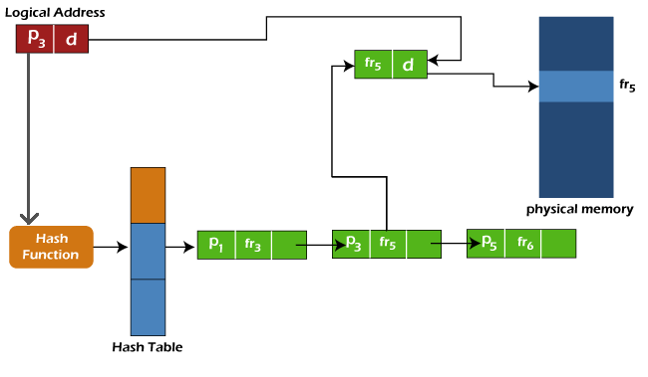

Slide 12
In this example, the logical address includes page number P₃ which does not match the first element of the link list as it includes page number P₁.
So we will move ahead and check the next element; now, this element has a page number entry, i.e., P3, so further, we will check the frame entry of the element, which is fr₅.
We will append the offset provided in the logical address to this frame number to reach the page's physical address.
So, this is how the hashed page table works to map the logical address to the physical address.

Slide 13
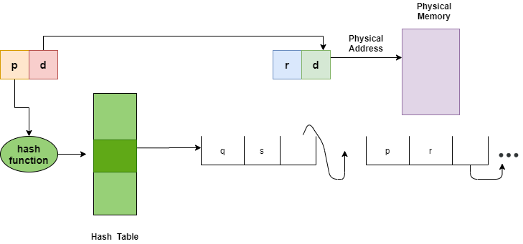
Fig. Hashed Page Table

Slide 14
Inverted Page Tables
The Inverted Page table basically combines A page table and A frame table into a single data structure.
There is one entry for each virtual page number and a real page of memory
And the entry mainly consists of the virtual address of the page stored in that real memory location along with the information about the process that owns the page.
Though this technique decreases the memory that is needed to store each page table; but it also increases the time that is needed to search the table whenever a page reference occurs.

Slide 15
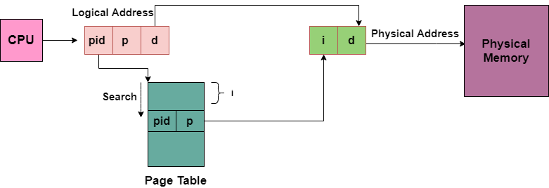
Given below figure shows the address translation scheme of the Inverted Page Table:
In this, we need to keep the track of process id of each entry, because many processes may have the same logical addresses.
Also, many entries can map into the same index in the page table after going through the hash function. Thus chaining is used in order to handle this.

